Slide 1




Machine Learning
Chapter 3-1 Confusion Matrix
START

Slide 2
Machine Learning
Confusion Matrix
Recall(재현율) = TP / (TP+FN)
Precision(정밀도) = TP / (TP+FP)
Accuracy(정확도) = (TP+TN) / (TP+FP+FN+TN)
Predicted
No
Yes
No
TN
FP
Actual
Yes
FN
TP

Slide 3
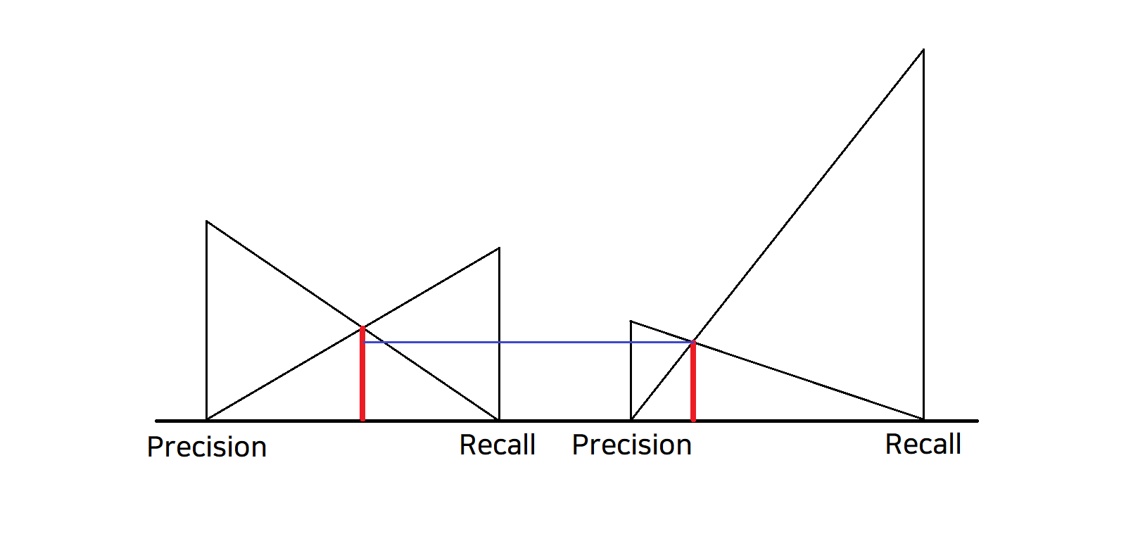
Machine Learning
Confusion Matrix
F1-Score = 2 * (P * R) / (P + R)

Slide 4
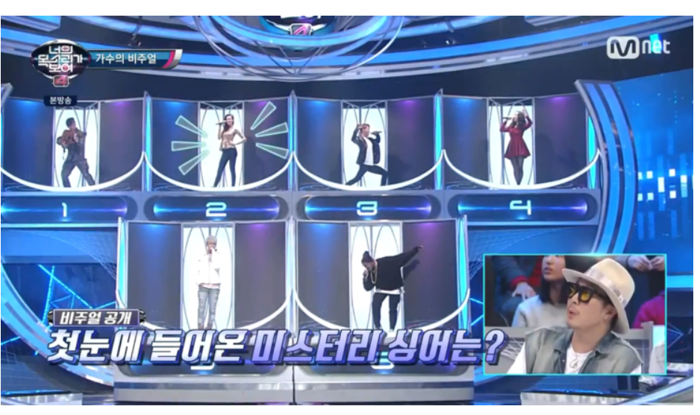
Machine Learning
Confusion Matrix
번호 [ 1 , 2 , 3 , 4 , 5 , 6 ]
예측 : [음치,음치,가수,가수,가수,가수]
정답 : [음치,음치,음치,음치,가수,가수]
정확도와 정밀도, 재현율은 몇일까?

